Slide 1
Jet-veto Resummation for Gauge boson Pair
Yan Wang
Based on Phys. Rev. D 88, 114017 (2013),
arXiv:1504.00509 [hep-ph]
Mini workshop for CEPC
2015-10-19
Notes:
Today, I will report about jet-veto resummation for gauge boson pair production at the LHC. Hope that the conclusion in this work can also inspire some thought for the CEPC. This report is based on two works, one is published before, and one is submitted.

Slide 2
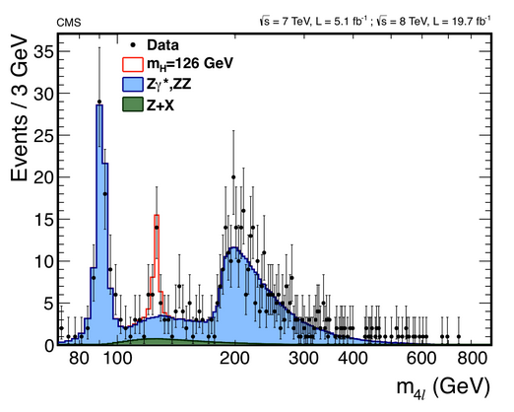
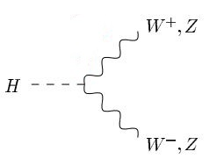
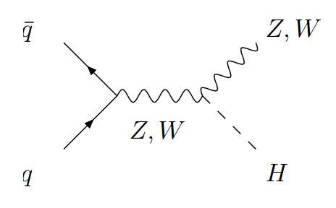
Irreducible background
Irreducible background for Higgs boson, models such as Supersymmetry and extended Higgs sectors and so on.
Notes:
We know that the gauge boson pair is the irreducible background for Higgs boson production. Even for many other heavy New physics particles in the New physics.

Slide 3
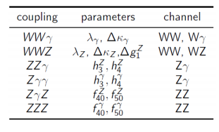
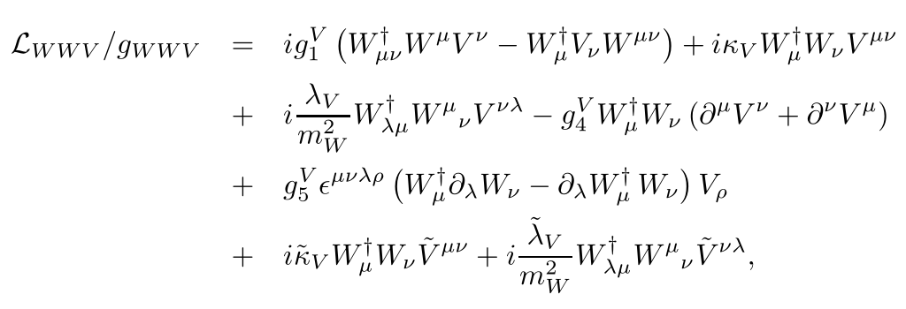
Testing Standard Model (TGCs)
TGC ---- fundamental predictions of the non-Abelian SU(2)×U(1) gauge structure of electroweak theory.
In SM, no neutral TGC vertex at LO.
Charged TGC vertex at LO are only
$λ_{γ}=λ_{Z}=0$
$g_{Z}^{1}=κ_{γ}=κ_{Z}=1$
G. J. Gounaris, et. al. Phys. Rev. D 62, 073013 (2000).
K. Hagiwara, et. Al. NPB 282 253 (1987).
Notes:
It is also important for test tri-gauge boson couplings. We use high-dimension effective operator as I collected here. In SM, there is no neutral TGC vertex at LO, the charged TGC vertex is . So if we find some excess between the experiment and the SM theory, we can fit the experimental data with the coupling of effective operator.

Slide 4
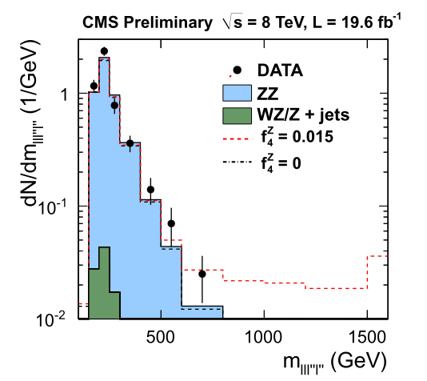
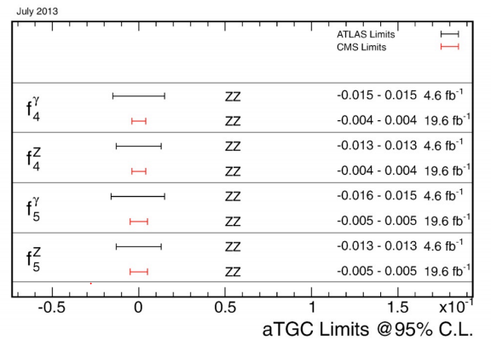
Testing Standard Model
At interesting region
At the one-loop level, fermion
triangles generate nTGCs : ${10}^{−4}$,
G. J. Gounaris, et. al. PRD 62, 073013 (2000).
Many new physics models predict
values of nTGCs :${10}^{−4}$ ~ ${10}^{−3}$.
J. Ellison and J.Wudka, Annu. Rev. Nucl. Part.
Sci. 48,33 (1998).
aTGC effects: often increase cross sections at high invariant mass ($M_{VV}$) and its proxies ($q_{T}$)
U. Baur et. al. PRD 53, 1098 (1996)
Notes:
At present at the LHC, the precision of the experiment has reach the same level as the LEP， which is about ten to the minus 2 or minus 3. And the QCD NLO correction and the New physics effects also give an increment of order ten to minus 3 or minus four. So we can distinguish the effects from the SM QCD high order correction from the New physics by the experiments now. Because the manifestation of them are different.

Slide 5
The theoretical predictions Gauge Boson Pair Production
Beyond QCD NLO
G. Chachamis, M. Czakon, and D. Eiras, JHEP 12 (2008) 003.
F. Campanario and S. Sapeta, Phys. Lett. B 718, 100 (2012).
M. Grazzini, JHEP 01, 15 (2006)
R. Frederix, M. Grazzini, PLB 662, 353 (2008)
S. Dawson, I.M. Lewis, and M. Zeng, Phys. Rev. D 88, 054028 (2013).
P. Meade, H. Ramani, and M. Zeng, Phys. Rev. D 90, 114006 (2014)
QCD NNLO
WW production: T. Gehrmann, et al., Phys.Rev.Lett. 113, 212001 (2014)
ZZ production: F. Cascioli, et al., Phys.Lett. B 735, 311 (2014)
Notes:
For high order QCD calculation of the gauge boson pair has been pursued for a long time. The QCD NLO has been combined into MCFM package. And beyond QCD NLO, there are some paper discussing resummation effects and approximate NNLO in some limits, such as in high transverse momentum or infinite mass approximation. And the QCD NNLO results are published in the last year. WZ results are not been reported yet.

Slide 6
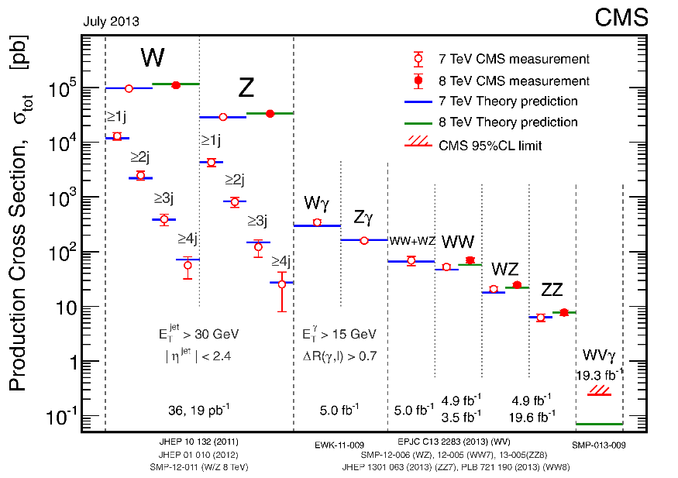
Total Cross Section in 2013
S. Dawson, et. al, PRD 88, 054028 (2013).
T. Gehrmann, et al., PRL. 113, 212001 (2014)
NLO | $54.7_{−1.0}^{+1.4}$ (pb)
NNLL | $57.3_{−1.6}^{+2.3}$ (pb)
NNLO | ${59.8}_{−1.1}^{+1.3}$ (pb)
Exp(CMS) | $69.9±2.8±5.6±3.1$ (pb)
Exp(ATLAS) | $71.4{{ _{−1.2−4.0−2.1}^{+1.2+5.0+2.2}}^{ }}^{ }$(pb)
(MSTW2008 PDF)
P. Monn, G. Zanderighi 1410.4745
Notes:
So we can see the Table, the NLO results are calculated by MCFM, The NNLL refers to the Dawson’s NNLL+NLO threshold resummation results, and NNLO si Gehrmann’s NNLO paper, all these results are calculated with MSTW2008 PDF. We can see that the QCD high order effects only provide about 10% increment.
However, in 2013, the ATLAS and CMS collaboration both publish their measurement and found that the experimental data had exceeded the theoretical prediction a lot.
How does this happened? These authors found that if we only compare the fiducial cross section, which means we only consider the WW decay to 4leptons with cuts for final states and without any jets, we don’t unfolded it into WW total cross sections, and there is no excess in the measurements compared to the NLO QCD predictions

Slide 7
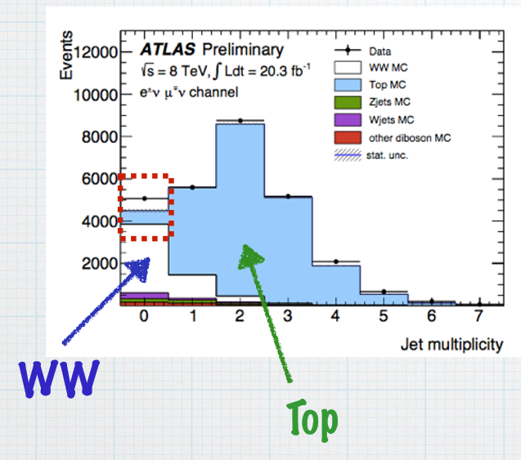
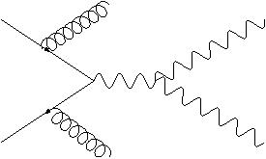
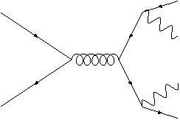
Jet Veto
$t\overline{t}$ production is an irreducible background with additional energetic jets to the VZ associated production at hadron colliders.
Required $p_{T}<p_{T,veto}$
$$b$$
$$W$$
To suppress the unwanted backgrounds ($t\overline{t}$), a jet veto procedure $p_{T,veto}∼30 GeV$ should be considered.
$$W$$
$$b$$
Notes:
What does this can tell us?
The main difference between a fiducial cross section and the total cross section is that fiducial cross section only consider the 4-lepton final states without any jets. It, actually, equivalent to the cross section for jet veto. And we don’t include the cross section for WW+1jet and WW+2jets and so on.
And we will introduce a scale, which is the veto scale of the transverse momentum of jets, which is often set at 25 GeV or 30 GeV.
Such technique is often used in the experiments, and the benefit is that it can reduce the background . For Example, ttbar is the irreducible background
For WW production, but if we class them by jet numner., and we can see from the figure that the background of WW+0jet bin is very small, while it suffer a very large background in other bins.
We class them though the scale of pt_veto, which means if the jet’s pt larger than pt_veto, we discard the event.

Slide 8
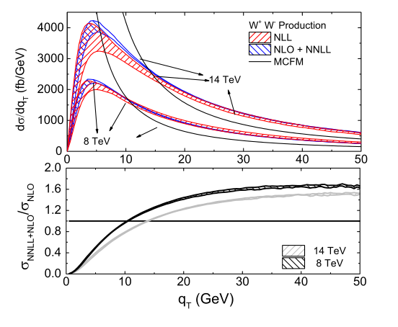
Transverse Momentum Distribution
$$\frac{σ_{\exp{ }}^{veto}}{σ_{exp}^{total}} = \frac{σ_{theo}^{veto}}{σ_{theo}^{total}}$$
Veto efficiency:
simulated by software,
often POWHEG+PYTHIA
YW, Chong Sheng Li, Ze Long Liu,
Ding Yu Shao and Hai Tao Li,
Phys. Rev. D 88, 114017 (2013)
Notes:
Then we can extrapolate the measured fiducial cross section through data driven Monte Carlo (MC) acceptances to gain the inclusive cross section.
The method is if the experiment and theory are both correct, we will get the equation here. The sigma_veto is measured in the experiments and what’s on the right can be simulated by MC. So the sigma_total is what reported in the experiment paperAnd we believe the cuts for leptons and detector resolution will not affect the final conclusion.
Now we know that sigma_veto is the same with QCD NLO predictions, but sigma_total is larger than the prediction. So the problem is most likely happened on the right side, which is simulated by the software, and CMS and ATALS use POWHEG+PYTHIA here.
So in order to check whether the POWHEG give the right simulation, we study the NLO+NNLL resummaiton for the transverse momentum distribution for gauge boson pair. We calculated WW, WZ and ZZ case

Slide 9
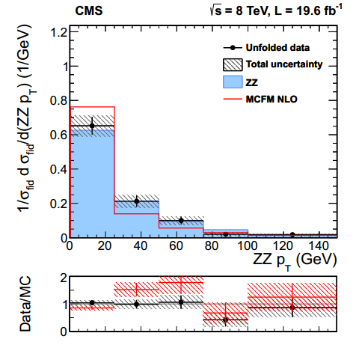
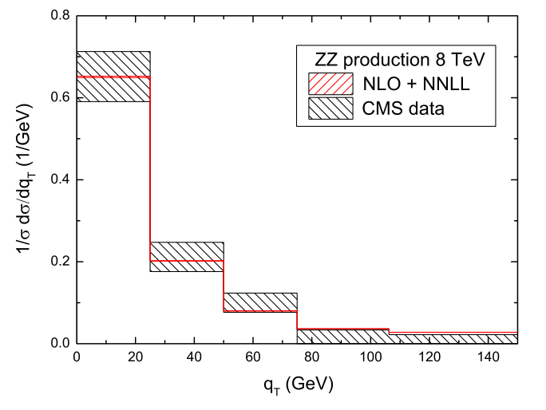
Transverse Momentum Distribution
YW, Chong Sheng Li, Ze Long Liu, Ding Yu Shao and Hai Tao Li, Phys. Rev. D 88, 114017 (2013)
$$σ_{exp}^{total}=\frac{σ_{\exp{ }}^{veto}}{\frac{σ_{veto}}{σ_{total}}}$$
Notes:
However, at that time, there is no excess experiment for WW cross section. So we only compare the ZZ case in the paper. But the situation for ZZ and WW is very similar. So we can have the same conclusion for them.
In this two figures, the first one is given by the experiment and the blue area is POWHEG+PYTHIA results, which is still a little different from the experimental data. The second one is our resummation results, which improve the POWHEG results and is completely agree with the experiment.
So we can find that the POWHEG results underestimate the sigma_veto, so give a larger total cross section.

Slide 10
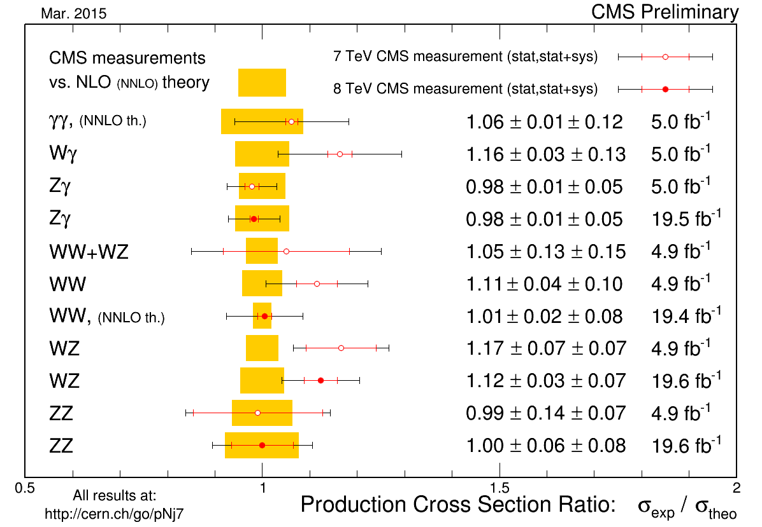
Total Cross Section in 2015
CMS PAS SMP-14-016
The simulated POWHEG events are reweighted by the NNLL transverse momentum resummation predictions.
Notes:
The CMS collaboration then use the NNLL transverse momentum resummation predictions to reweight the POWHEG results, and gain the new experimental total cross section, it decreases a lot compared to the former results, and is consistent with the NNLO predictions.

Slide 11
The Total Cross Section For WZ And ZZ Production
lumi.
exp.
NLO
The measurements for ZZ production is consistent with
NLO predictions, But $\frac{σ_{NNLO}}{σ_{NLO}}=1.12$ when √s=8 TeV
CMS PAS SMP-13-005
F. Cascioli, et al., PLB 735, 311 (2014)
There are about 2$σ$ discrepancies for WZ productions in the CMS measurements
CMS PAS SMP-12-006
Notes:
And there is also an excess in CMS experiment for WZ process. And the ATLAS results is consistent with NLO predictions. And for ZZ production, though measurements agree with NLO predictions, But the NNLO corrections for ZZ production increase the NLO result by 12% when √s=8 TeV. So we also need to check these two process.

Slide 12
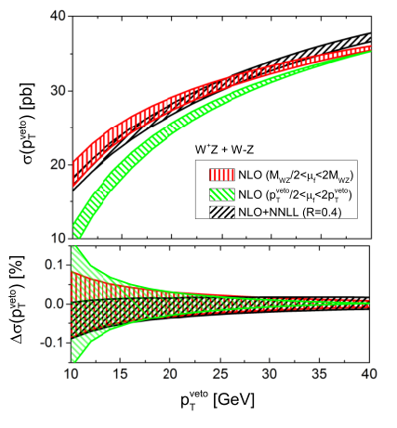
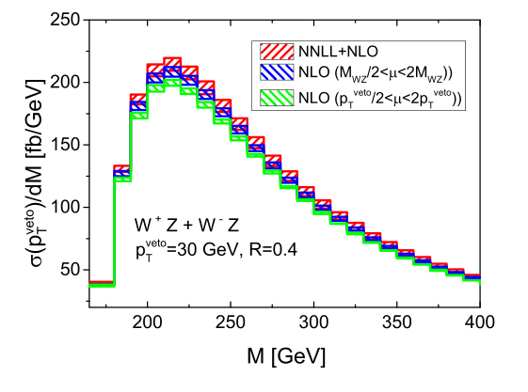
Resummed Prediction
WY, Chong Sheng Li, Ze Long Liu, arXiv:1504.00509 [hep-ph]
$$α_{s}^{n}{\ln^{k}({\frac{p_{T}^{veto}}{Q})}}^{ }$$
The comparison of the jet-veto NLO and jet-veto NLO+NNLL resummation
The invariant mass distributions
Notes:
This time we study the jet veto cross section in an analytical way, not integrate the pt distribution, but gain the jet-veto cross section directly. This is the logarithm we want to resumed.
At the beginning, I present some details.
First is the comparison of the NLO and NLO+NNLL resummation, including the jet-veto cross section and invariant mass distribution.
The variables will changed a lot if we consider the resummation.

Slide 13
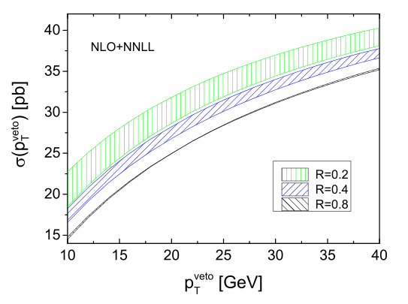
Resummed Prediction
The NLL and NNLL jet vetoed with different jet veto $p_{T}^{veto}$
and jet radius R.
Notes:
Here is the Jet radius R, which has the form of this. So the cross section decrease when R become larger. And the uncertainties also goes down.
(Another thing I don’t show here is when center-of-mass energy increase the theoretical uncertainties also goes down, the tendency is more obvious than the NLO prediction.)

Slide 14
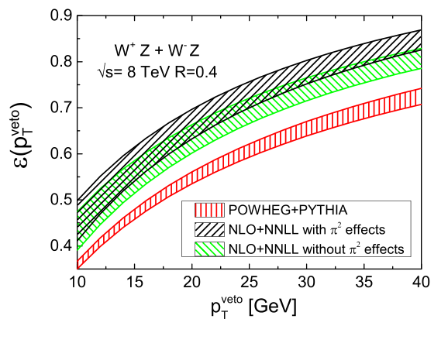
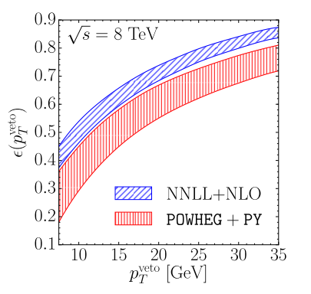
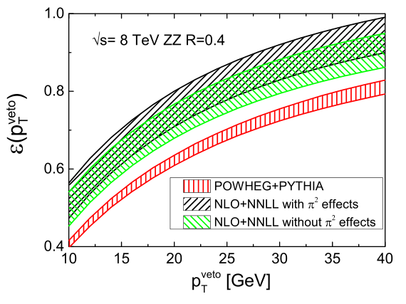
Compare With POWHEG+PYTHIA
$$ε=\frac{σ_{veto}}{σ_{total}}$$
P. Jaiswal, T. Okui, PRD.90.073009
WY, C-S. Li, Z-L. Liu, arXiv:1504.00509
Notes:
Here is main conclusion, in their paper and our works, we compare the jet-veto resummation results with POWHEG+PYTHIA and in the next page is comparison with aMC@NLO+PYTHIA. The y axis is the efficiencies which is defined as. For WW case, the POWHEG results is a little different because they use a different way to calculate the uncertainties , that is combine the uncertainties of 0jets and events larger than 1jets together. But the center value is almost at the same position with ours.

Slide 15
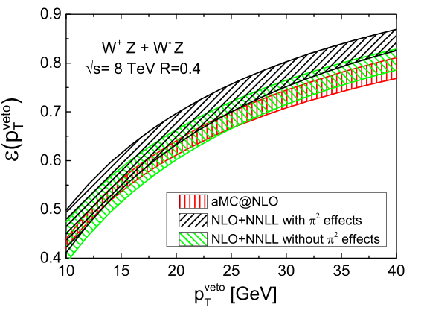
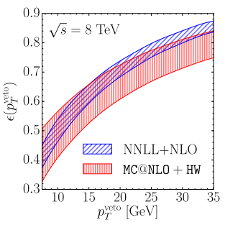
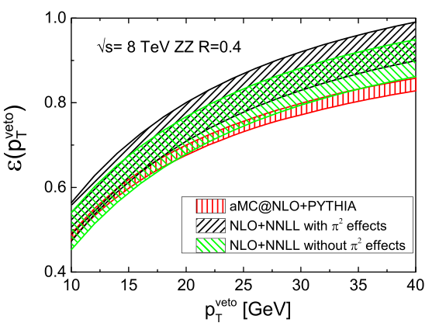
Compare With aMC@nlo+PYTHIA
Notes:
the POWHEG give a more lower efficiency. Not only compare to the NLO+NNLL resummation but also to the aMC@NLO. So it give a much higher cross section in the experiments.

Slide 16
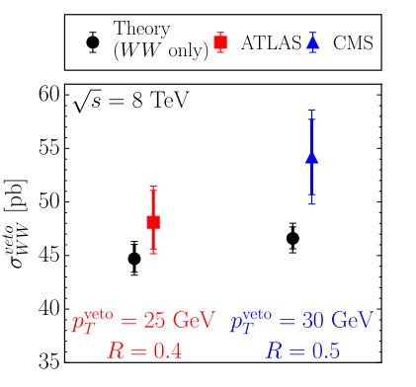
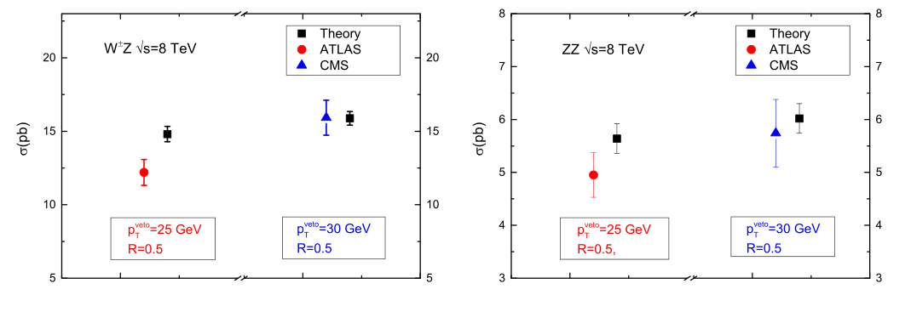
Compare With Exp.
$$σ_{\exp{ }}^{veto}=σ_{exp}^{inclusive}×ε$$
Notes:
If we only compare the experiment veto cross section with our prediction, We will find they are more consistent than before.
There is some discrepancy, like for WW production, however in CMS newest report, they use their own analysis to make the measurement agree with NNLO, as stated before. For WZ ATLAS result, there maybe also the same things happened.

Slide 17
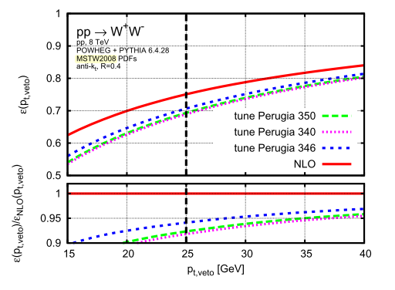
Tunes in POWHEG+PYTHIA
P. Monn, G. Zanderighi 1410.4745
Notes:
Because we use the default setting in POWHEG+PYTHIA, in this paper they said there at least 3 to 5 percent difference when choosing different parameters.

Slide 18
CONCLUSION
NLO + NNLL jet-veto resummation for gauge boson pair
POWHEG+PYTHIA underestimate NLO cross section
Reweight the cross section
Notes:
What can enlighten us is that high order correction is important not for the theoretical consideration, but for experimental measurement at least in this case, And the effects for high order correction should be considered process-by-process and observable-by-observables. At least, threshold resummation and resummation for jet final states are important at CEPC. I can’t make a assertion now.

