Slide 1
Monte-Carlo event generation for CEPC
Xin Mo
Institute of High Energy Physics
Oct. 19, 2015

Slide 2
Outline
Introduction of CEPC generation work
Basic information
Higgs physics
NLO plans
Electroweak & QCD
Sample & validation

Slide 3
Basic information
Sample information:
CM energy: 250GeV
Luminosity: 5000fb⁻¹ Polarization: unpolarized
ISR: on Beamstrahlung: off
Generator
Matrix element: Whizard1.95
Shower & hadronization: Pythia6.4

Slide 4
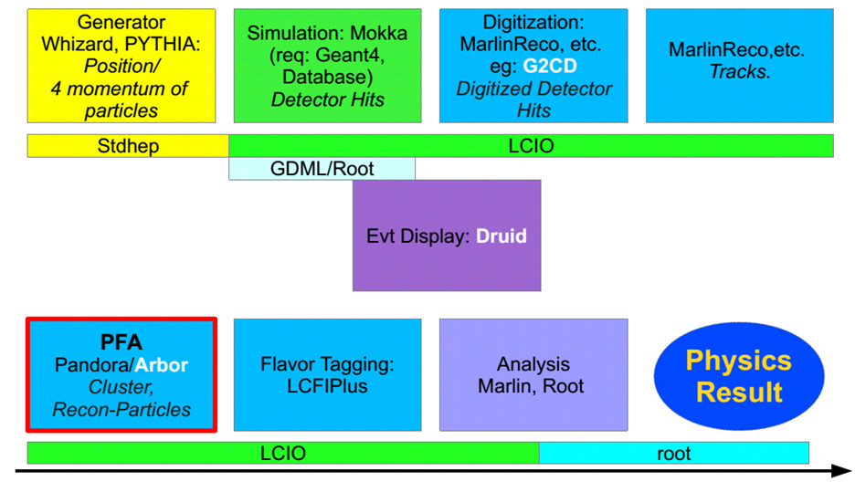
Workflow

Slide 5
Stdhep
Geant4, Mokka
Whizard, Pythia
Marlin
Root
Stdhep

Slide 6
Physics
Signal part (Higgs)
SM Background
2 fermions
4 fermions

Slide 7
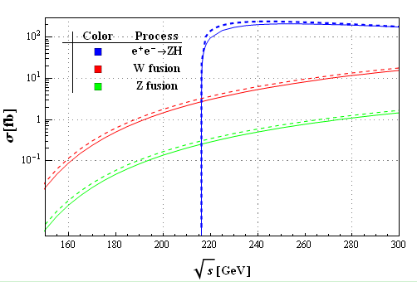
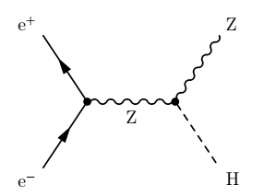
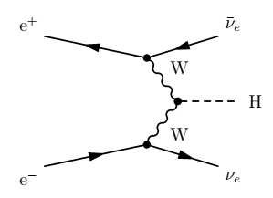
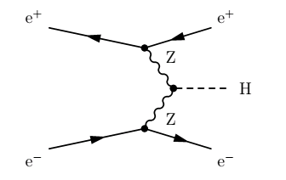
Higgs signal
Higgs-strahlung
Vector boson fusion

Slide 8
Classification of 4 fermions
WW type
Mixing type
ZZ type
Single W type
Single mixing type
Single Z type

Slide 9
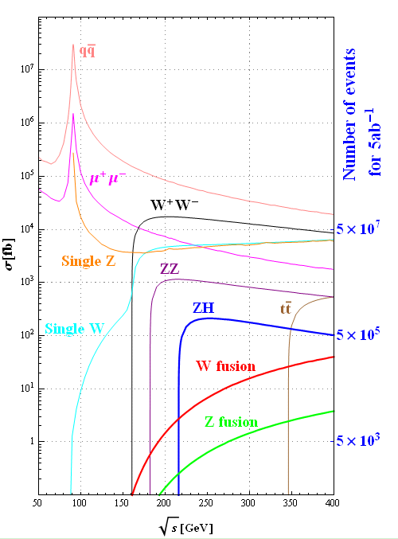
Summary table
Cross sections [fb]
 | 240GeV | 250GeV
qq | 54662 | 50216
μ⁺μ⁻ | 4685 | 4405
single Z | 4538 | 4734
single W | 5086 | 5144
W⁺W⁻ | 16004 | 15484
ZZ | 1079 | 1033
ZH | 203 | 212
W fusion | 5.36 | 6.72
Z fusion | 0.50 | 0.63

Slide 10
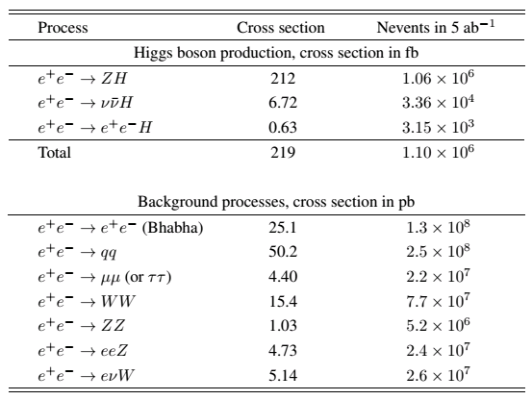
Number of events

Slide 11
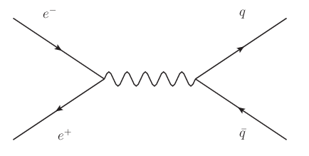
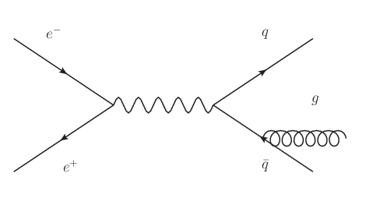
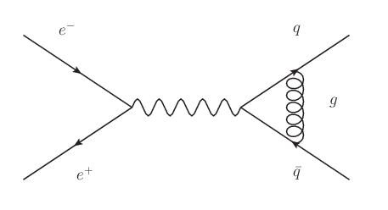
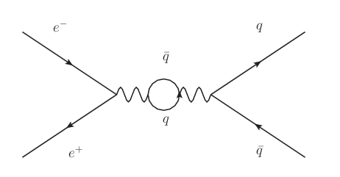
NLO process
Leading order:
Omega
Next-to-Leading order:
Openloops
Radiation
Vertex correction
Loop correction

Slide 12
Interfaces
OpenLoops for one-loop calculation; QCD correction
Powheg for shower matching
stdhep, lcio, lhe outputs

Slide 13
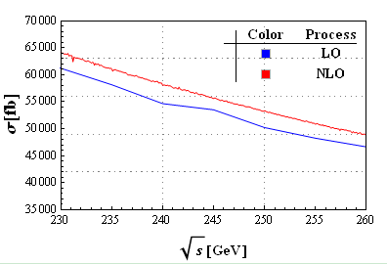
Cross sections
250GeV
ISR & beamstrahlung
 | NLO | LO
uu | 11121 | 10760
dd | 10227 | 9829
cc | 11068 | 10459
ss | 10100 | 9902
bb | 10237 | 9822
LO vs NLO

Slide 14
NLO event generation
Matching
Openloops
Powheg
Whizard
Loop calculation
HepMC
LHEF
Pythia8
Hadronize

Slide 15
Validation
Monte-Carlo truth level
Fast simulation
Full simulation

Slide 16
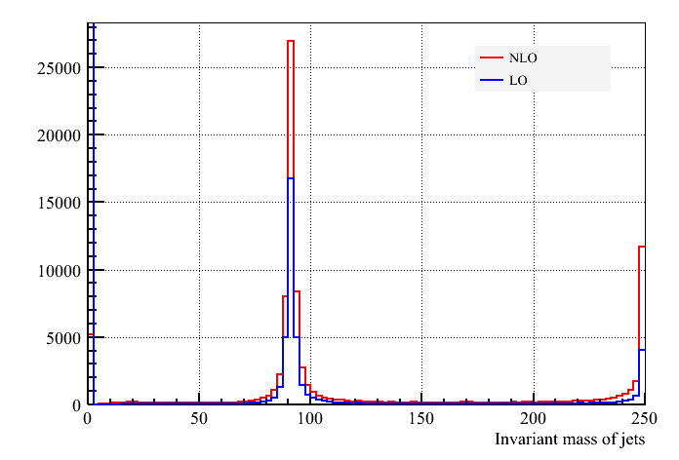
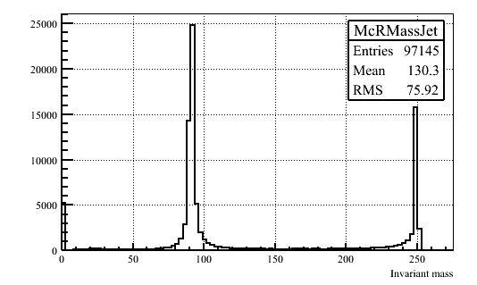
Invariant mass check
Monte-Carlo truth
LO vs NLO

Slide 17
Some plans for future
Validation for benchmark samples
A cross check
Madgraph, Powheg
My Email address: moxin@ihep.ac.cn
Office: Main building room B229 in IHEP

Slide 18
Thanks
Thanks for attention!

Slide 19
Backup
Backup

